Slide 1
LIVSPACE ANALYSIS
Using SWOT Frameworks

Slide 2

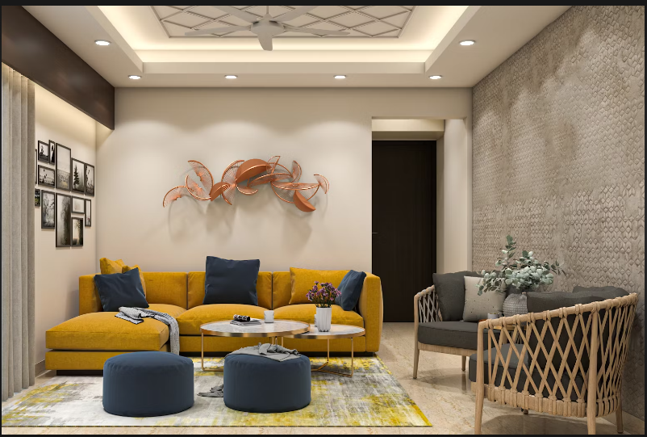
Designer and producer of home decor items meant to furnish houses in a dependable and personalized manner. The company offers clients a one-stop shop from design to installation by assisting them in finding a range of interior designs for all kinds of spaces, customizing the design by color, material, and style, and achieving the ideal look for houses..

Slide 3
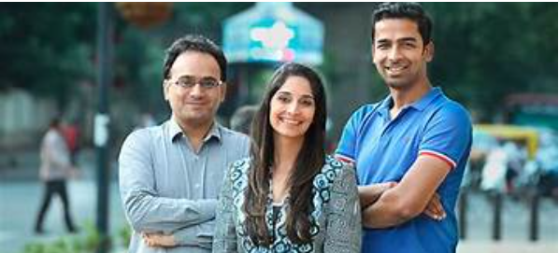
Founders
Anuj Srivastava
Anuj is an IIT Kanpur graduate, who also has an MBA from the London Business School. Srivastava is currently known as the CEO and Co-founder of Livspace.
Ramakant Sharma
Ramakant is the Founder and COO of Livspace. He is also an alumnus of IIT Kanpur and has an MBA from the Indian School of Business.
Shagufta Anurag
Shagufta Anurag has been a student of BArch and has completed his degree from BMS College of Engineering.

Slide 4
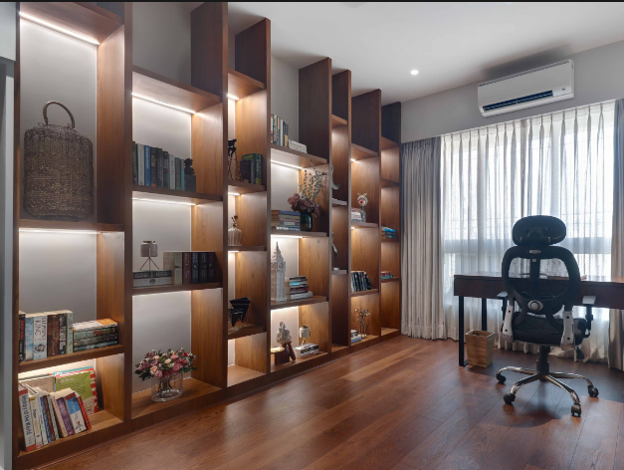
Livspace Overview
Type - Private
Industry - Interior Design
Founded - 2014
Headquarters - Bangalore
Employees - 4313
Investors - 23
Areas Served - 3 Countries
Deal Type & Amount - Later Stage VC & $25M
Competitors - Houssup, HomeLane,Hipcouch, Design Cafe and Furdo
Fundings Raised over time - $487M

Slide 5
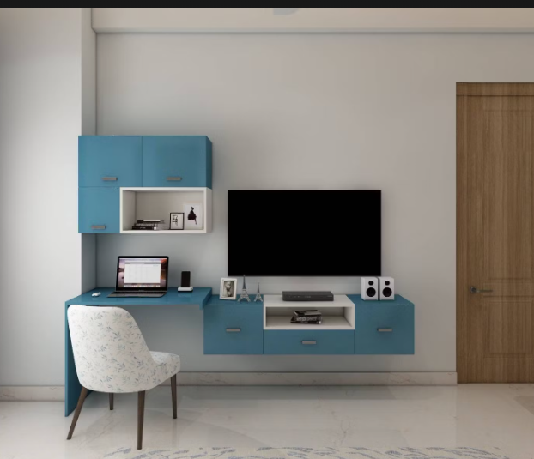
Business Model and Revenue Model
As a home design marketplace, the website links homeowners with vendors and designers. For every transaction, which might be as little as INR 1 lakh or as much as INR 50 lakh, it charges a commission or margin fee. Livspace functions as a three-sided marketplace that links suppliers and designers of goods and services for home design with homeowners.

Slide 6
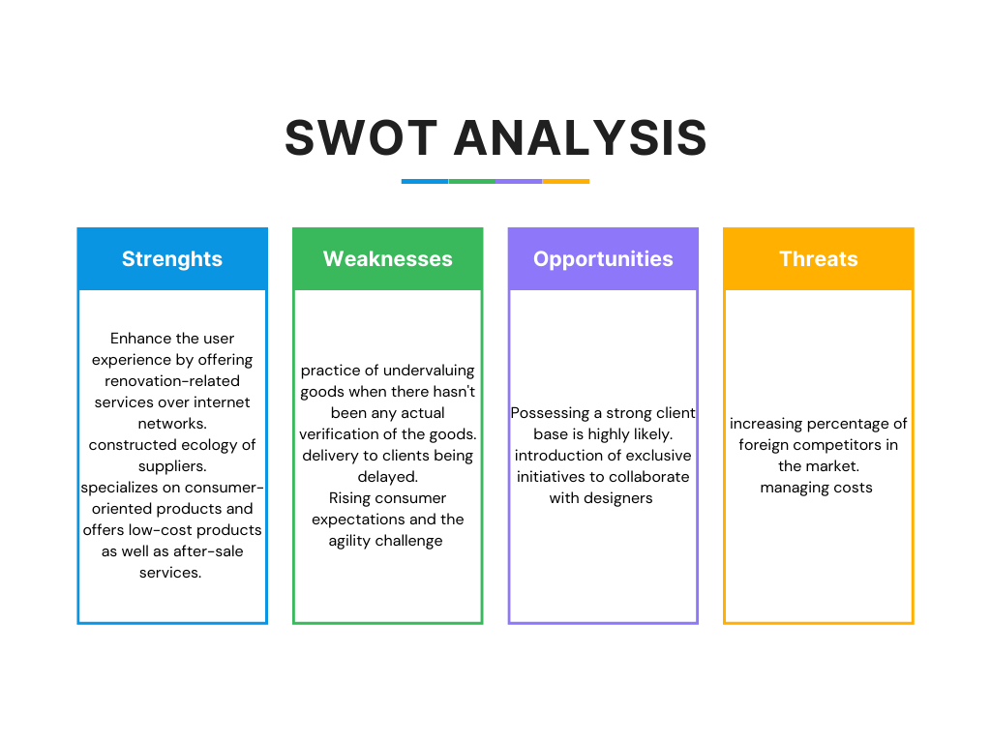
SWOT Analysis

Slide 7

Conclusion
Livspace is an interior design startup that offers a platform that connects people to designers, services, and products and allows users to buy customized wardrobes, modular kitchens, and other interiors. Determined to never let another homeowner experience the misery, they created Livspace. Launched in 2014 in India, Livspace is now the trusted brand for complete home interior design for thousands of homeowners.

Slide 8


